Slide 1
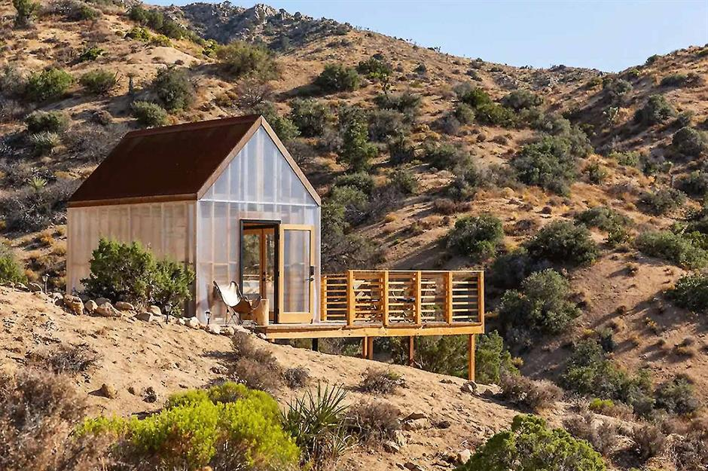
How to Get Your Apartment Off the Grid

Slide 2
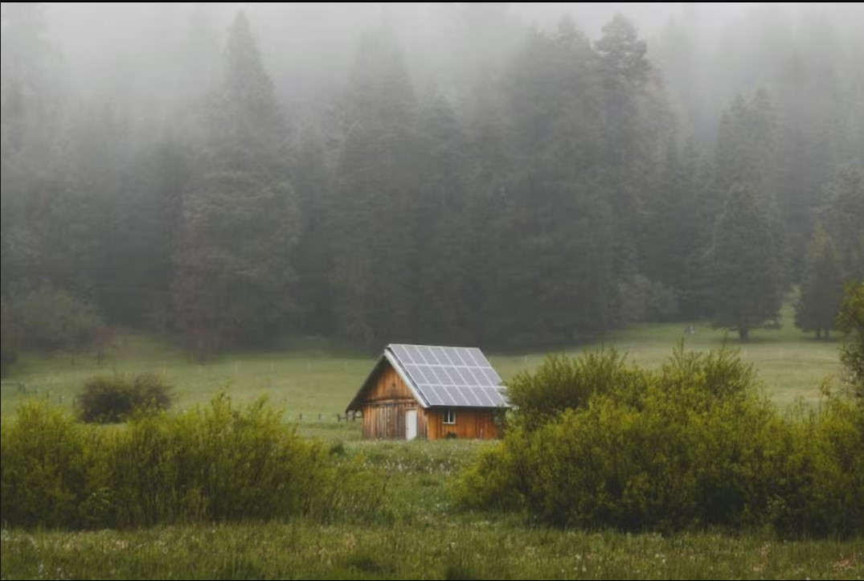
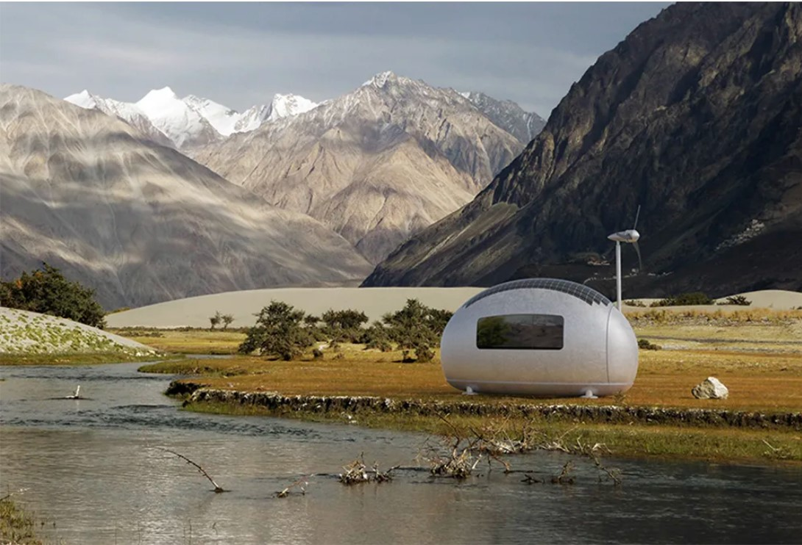
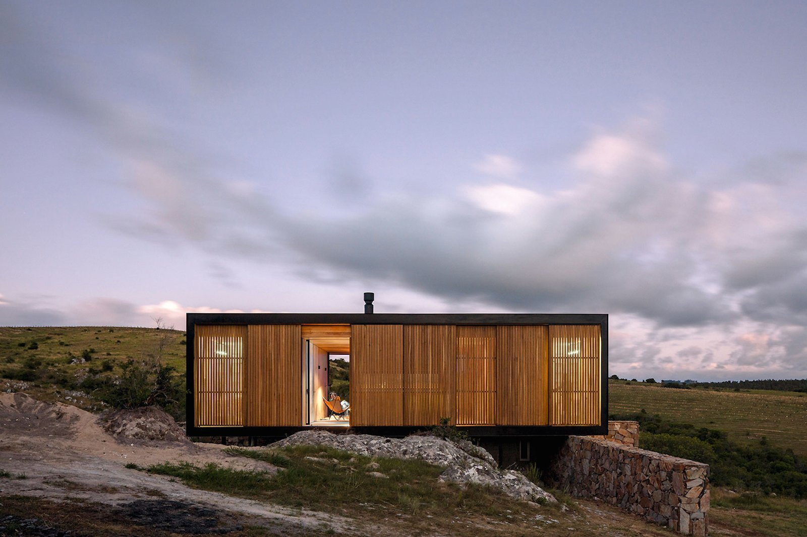

Slide 3
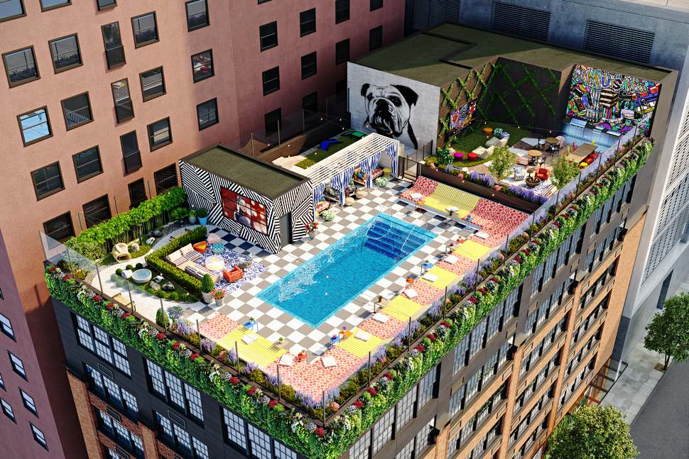
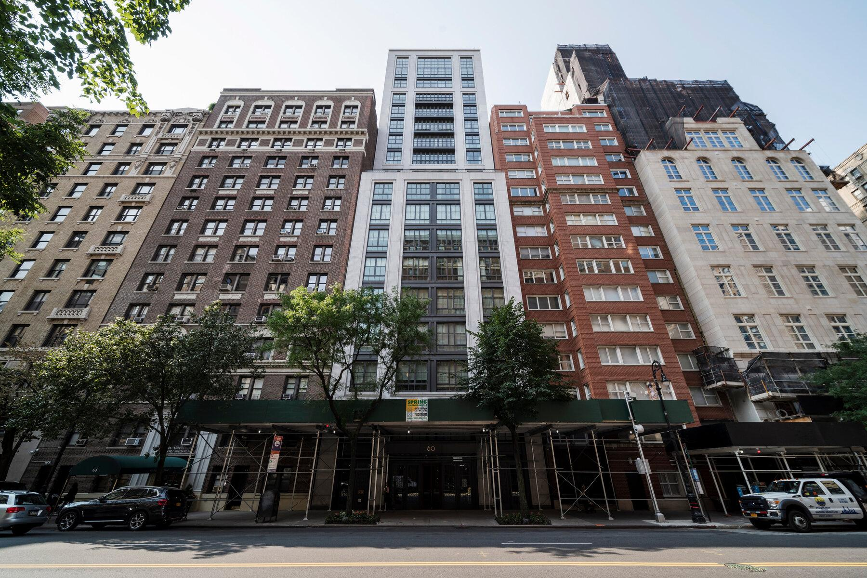
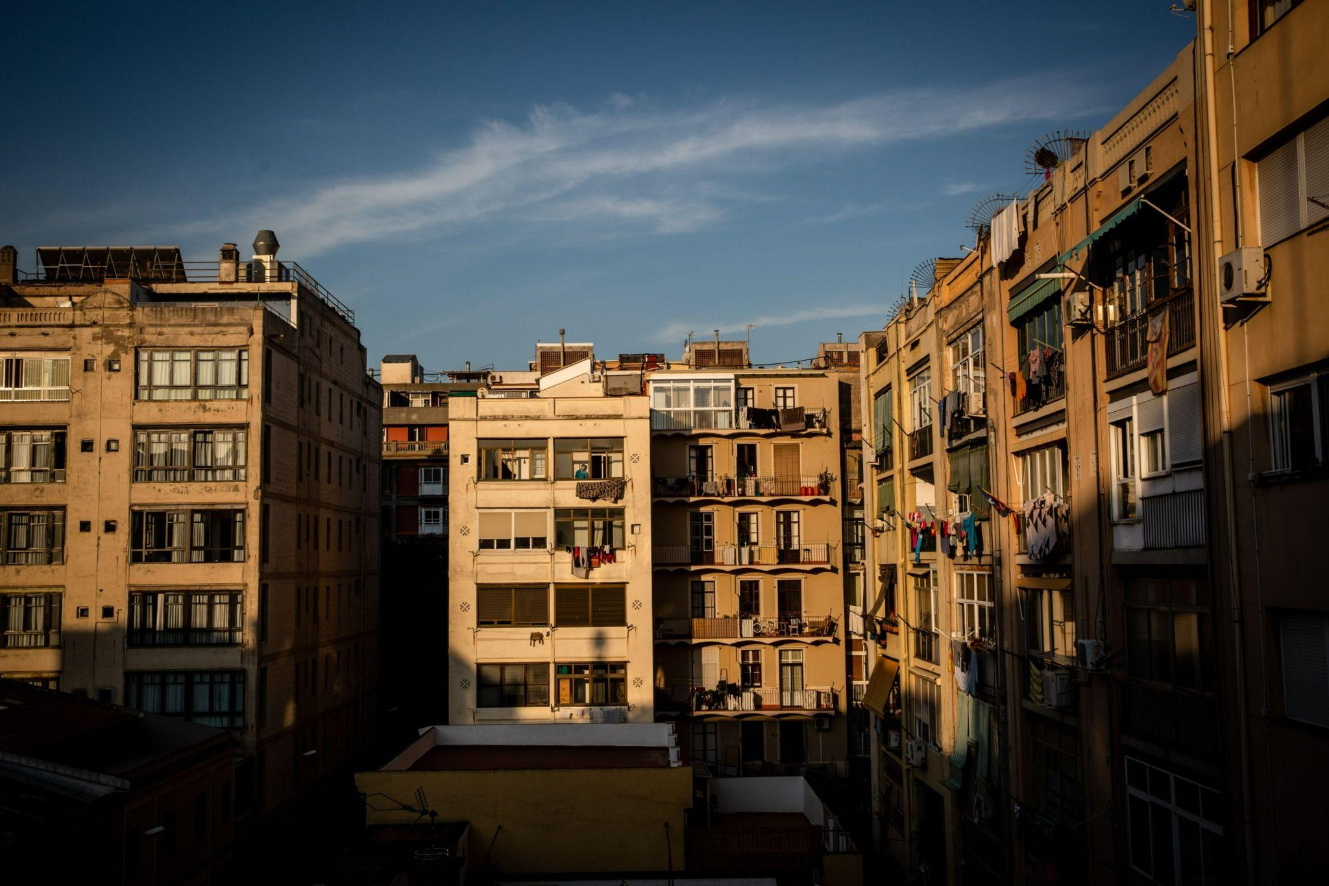

Slide 4
OBSTACLES
Solar photovoltaic (PV) installation is expensive. (The average pricing for a 5kW residential PV system completed in 2014 varied from $11,000 in Germany to $16,450 in the USA)
Not everybody lives in a single-family dwelling with access to a private roof
If you’re renting a place, whether it’s a house or an apartment

Slide 5
CASE STUDY
The apartment is located near Barcelona in Spain, a city with an average solar insolation of almost 1,700 kWh/m2/year (which is also the average figure across the USA). Furthermore, the 60m2 apartment has the balcony and all windows facing south-south-west, and there is no shading by trees or other buildings. Meaning it receives a lot of sunshine.

Slide 6
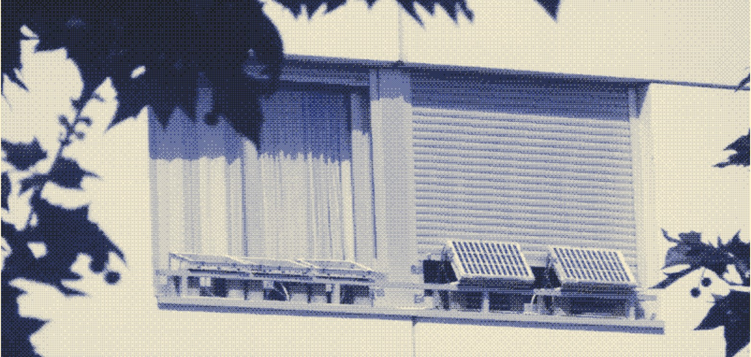
Winter without a heating system, relying only on solar heat and thermal underclothing.
Hot water is supplied by a solar boiler.
Clothes are air-dried on the balcony.
Solution: possibility to harvest solar power from the window sills and the balcony and take my apartment off the electricity grid.
PV installation would solve:
No access to the roof needed
Self installing system, which reduces the cost
The solar installation can be taken to another place.
HOW

Slide 7
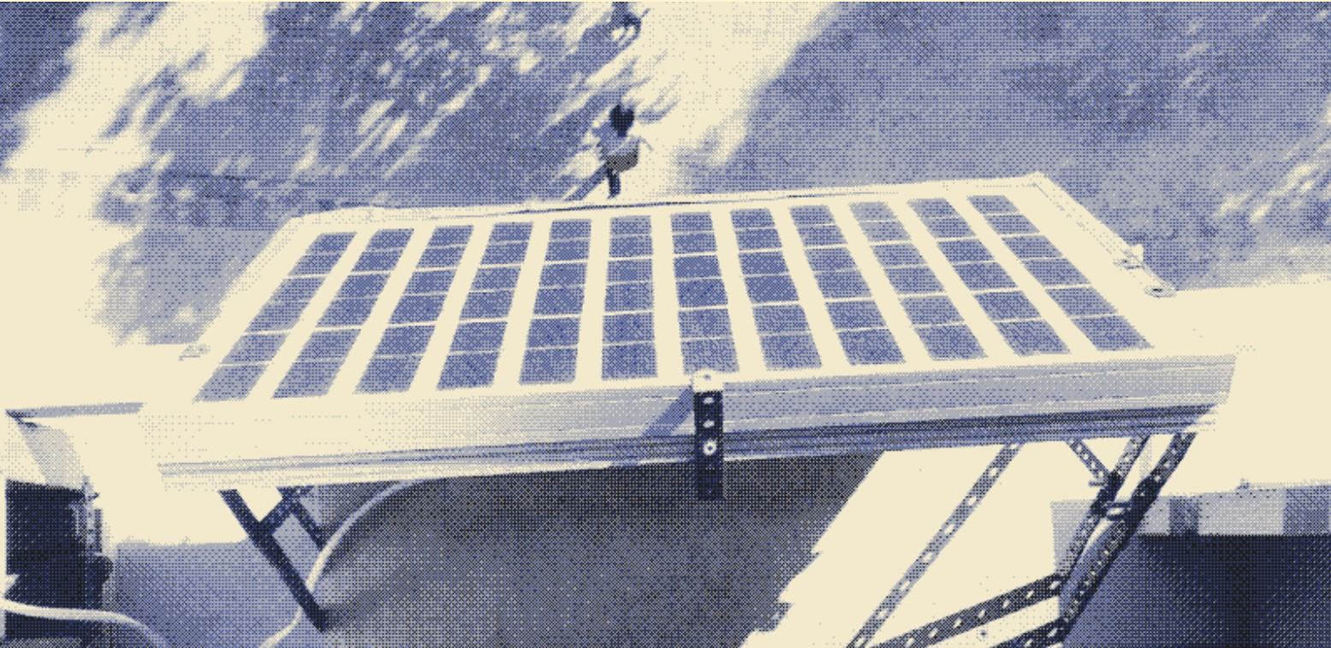
Maximize solar power production by tilting the panels according to the season.
Minimize power use by installing a low-voltage DC grid and using DC appliances.
Force yourself to lower energy demand on dark days by going off the grid.
STRATEGIES

Slide 8
CASE STUDY
While regular electricity use is at least 500 Wh on a 9-hour working day, the window sills gives a maximum of 400 Wh per day. On overcast days, energy production can be as low as 40 to 200 Wh per day, depending on the type of cloud cover.

Slide 9
CASE STUDY
“The choice for a DC system has lowered power consumption in my home office considerably. My laptop’s energy use has decreased by about 20%. Switching to DC-direct LED-lamps has halved power use for lighting from 35 to 16W. Based on the 9-hour working day, daily energy use of regularly used devices in my home office has come down from 500 to 350 Wh/day. This brings average energy use below energy production on sunny days (400 Wh), which are plentiful where I live.”

Slide 10
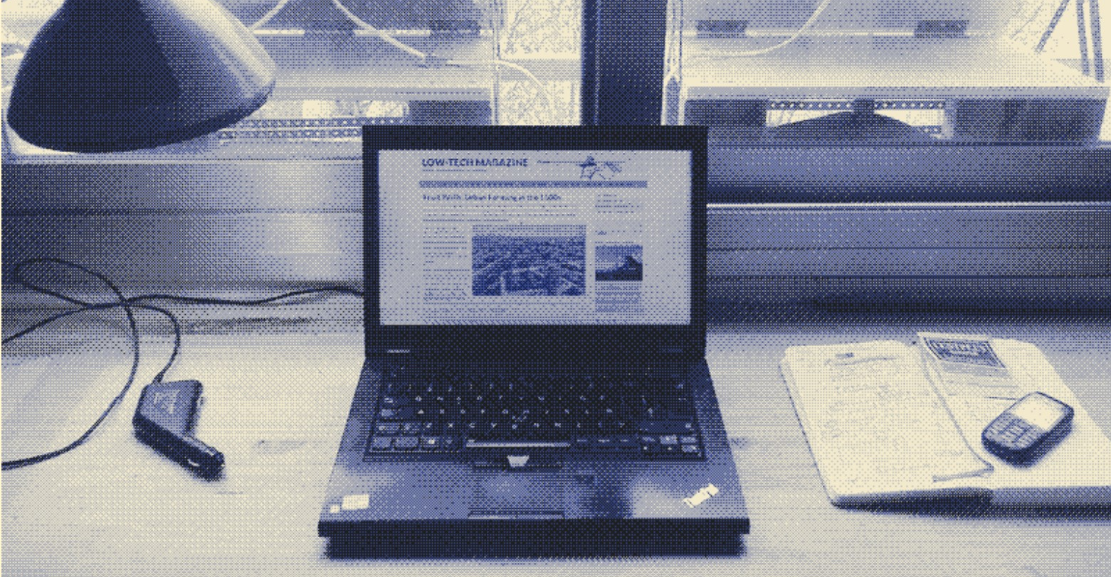
Installing a working desk right next to the window
Use less lights in evening during low solar power days
Shift loads towards sunny afternoons
Change working schedule
Adapt computer work to solar conditions
Stop using external computer screen
Work that doesn’t involve any energy use during the day, such as reading books and taking notes by hand.
Build a pedal powered generator when more electricity is needed during overcast days.
REDUCING ENERGY USE

Slide 11
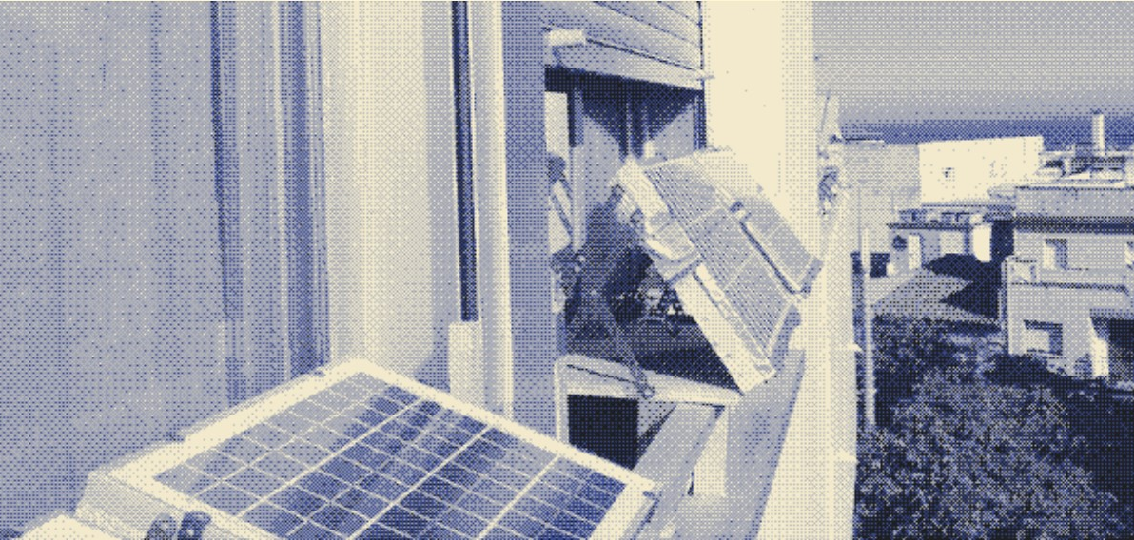
AWARENESS
Before deciding to install a low-tech solar PV system:
Need enough sun
Need the right exposure.
Be prepared to lower your energy use.
May be impossible to close some windows completely.
Converting your apartment to solar power doesn’t make you “100% sustainable”

